Slide 1
City University of Hong Kong
MS4224 Enterprise Data Mining
Group Name: Banco
Lai Tsz Yan (54032457)
Leung Wing Shan (54031210)
Tam Cheuk Yin (54050900)
Chen Lee Wei (54334785)
Lai Ka Him(54704010)

Slide 2
Background
Found in 2009, Banco is a Portugal bank which providing financial service
The bank is under good condition, but need some adjustment for improving the performance
Identify some potentail area that Banco can improve
2016-2017’s data will be used for the analysis
personal portfolio will be created for customers with unique customer ID

Slide 3
Data Overview
There are 4 main data sets used for our analysis:
Marketing Campaign
=>Record bank’s marketing campaign data
Loan Risk
=>Detail loan granted records of each customer with a repayment status and also a evaluation of customers
Loan Status
=> Information such as demographic, financial status and credit history
4. Past Product Record => Information of the history of what financial product did the customer subscribed

Slide 4
Objectives
To estimate customers’ credit score and evaluate the probability of loan default
To suggest useful marketing campaign and financial product to the group of customer
To find the best model to predict the interest rate by different variables from clients
To Evaluate effectiveness, efficiency and profitability of current direct marketing Campaign
Analyze the factors for active customer and predict whether a new customer will be actively use financial service in the bank

Slide 5
Objective 1
To estimate customers’ credit score and evaluate the probability of loan default

Slide 6
Objective 1 - issue
Whether the customers can pay back their loan on time is significant to bank.
Default on loan → the bank may charge them high interests and it is the business income for bank.
the bank may take the risk that it will lose money
customers cannot pay back the large amount of loan
To minimize the risk → estimate customers’ credit score and evaluate the probability of loan default
Notes:
Whether the customers can pay back their loan on time is significant to bank.
Default on loan → the bank may charge them high interests and it is the business income for bank. However, the bank may take the risk that it will lose money if customers cannot pay back the large amount of loan eventually.

Slide 7
objective 1 - methodology
Using credit scoring to build credit scorecard to each customers
Using logistic regression and decision tree to find out the relationship between Y(Good/Bad) and independent variable

Slide 8
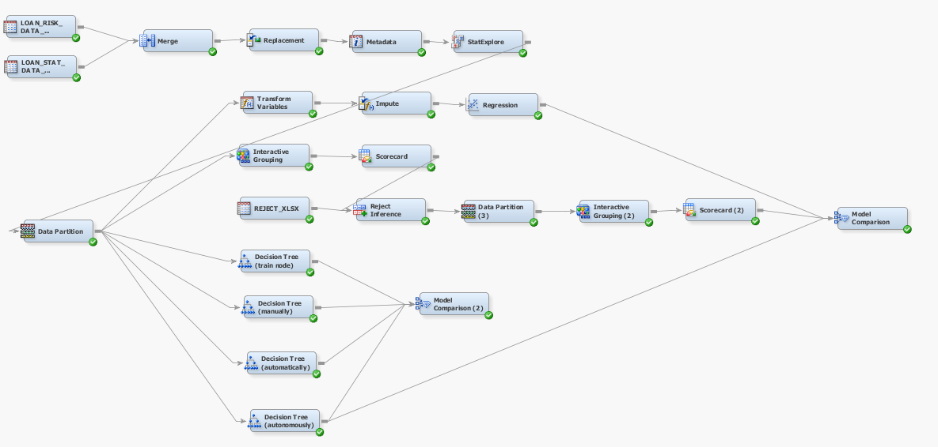
objective 1 - Models
Logistic regression, Credit Scoring, Decision trees
Credit scoring

Slide 9
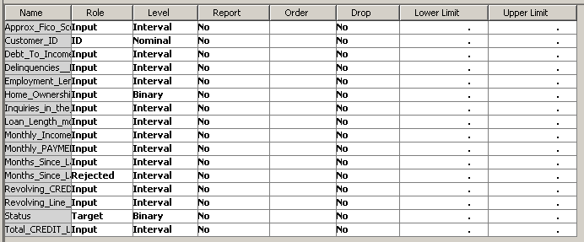
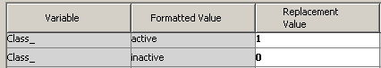
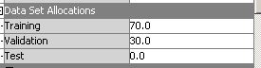
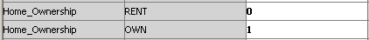
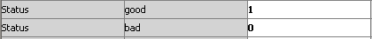
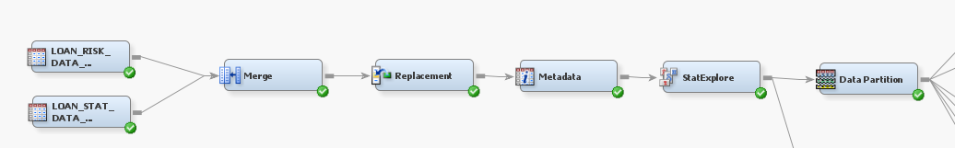
objective 1 - Data Preparation
Dataset : ( Loan_Risk_Data_accepts + Loan_Stat_Data_accepts) → Merge (791 obs)
Target: Status (Good / Bad)
Replacement: Class, Home_ownership, Status
Data partition: Traning(70%), Vaildation(30%)

Slide 10
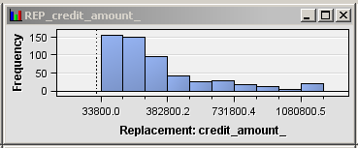
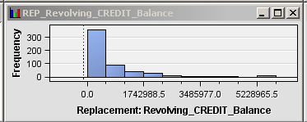
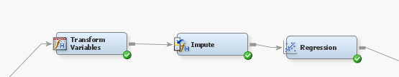
objective 1 - Logistic Regression
Dependent variable(Y) = Status (Good / Bad)
Data partition: Traning(70%), Vaildation(30%)
Transformation: Log transformation → ( credit_amount, revolving_credit_balance)
Impute: Count - nominal and binary data, mean - interval

Slide 11
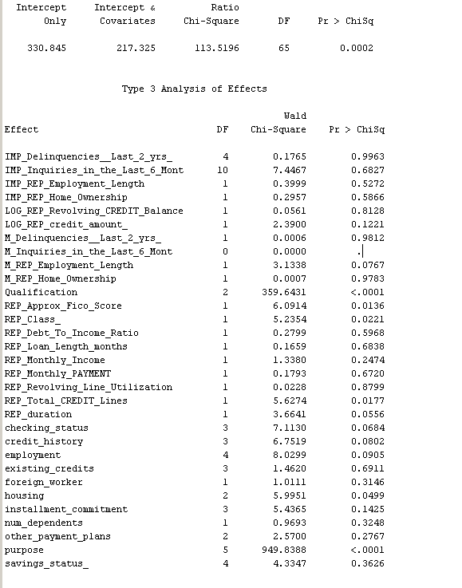
objective 1 - Logistic Regression (Results)
overall significant
Significant variables:
Qualification, Approx_Fico_Score, Total_credit_lines, Housing, purpose

Slide 12
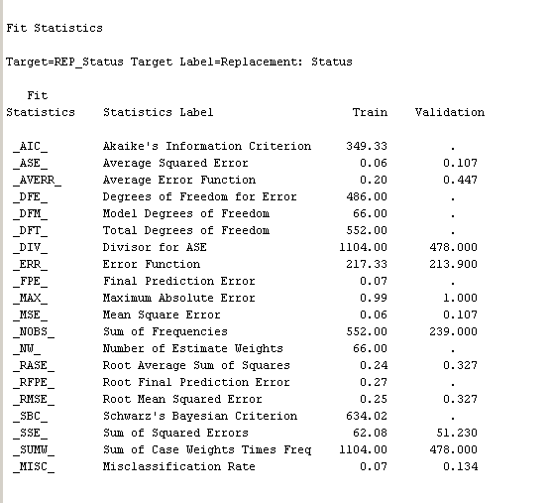
objective 1 - Logistic Regression
 | Train | Vaildation
Average Squared Error (ASE) | 0.06 | 0.107
Misclassification Rate | 0.07 | 0.134

Slide 13
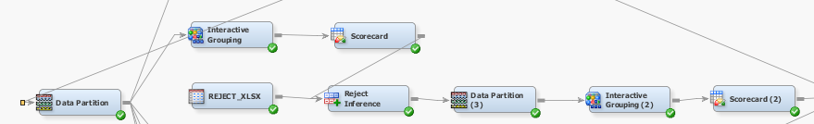
objective 1 - Credit Scoring
Data partition: Traning(70%), Vaildation(30%)
Interactive grouping: User-specific → Cut of value (IV=0.01)

Slide 14
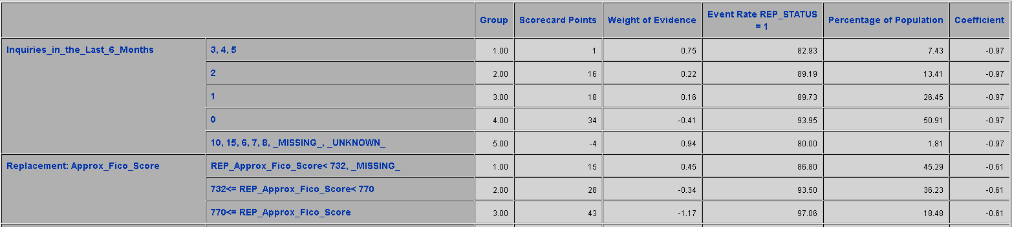
objective 1 - Credit Scoring(Results-Accepts)
Scorecard
high WOE = higher probability of being good

Slide 15
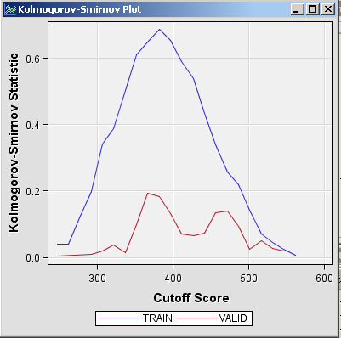
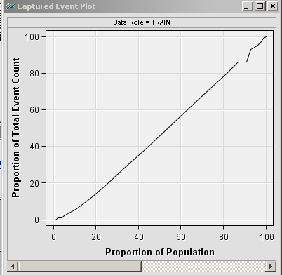
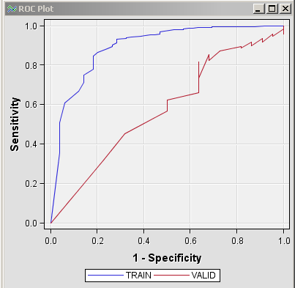
objective 1 - Credit Scoring(Results-Accepts)
Best Cut-off score (define good and bad)
=367
Captured Event Plot
ROC Plot

Slide 16
objective 1 - Credit Scoring(Results-Rejects)
Reject Datasets: 209 obs
Rejects inference - inferred good/bad loan status for the rejected applicants

Slide 17
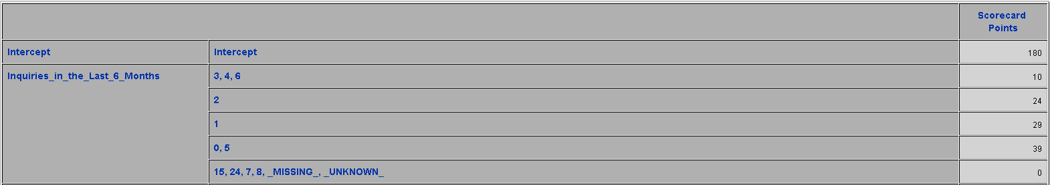
objective 1 - Credit Scoring(Results-Rejects)
Scorecard

Slide 18
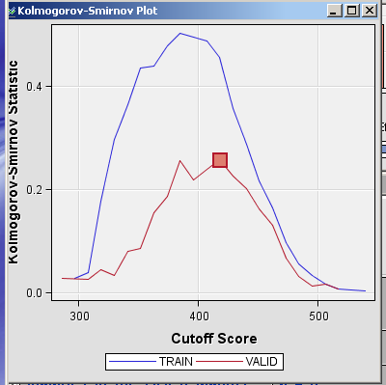
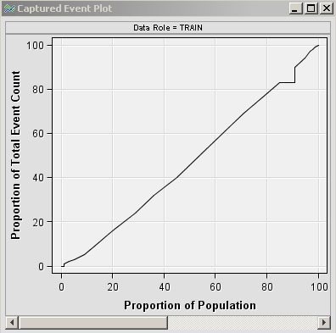
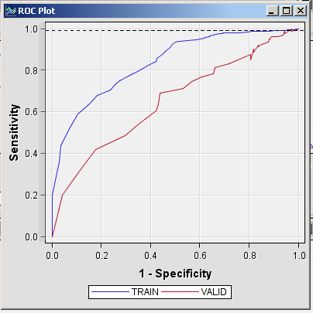
objective 1 - Credit Scoring(Results-Rejects)
Captured Event Plot
Best Cut-off score (define good and bad)
=418
ROC Plot

Slide 19
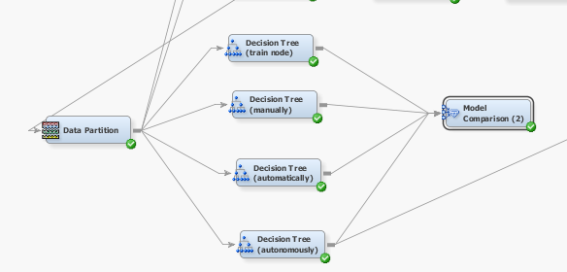
objective 1 - Decision Tree
Decision tree(train node), Decision tree(manually), Decision tree(automatically),Decision tree(autonomously)

Slide 20
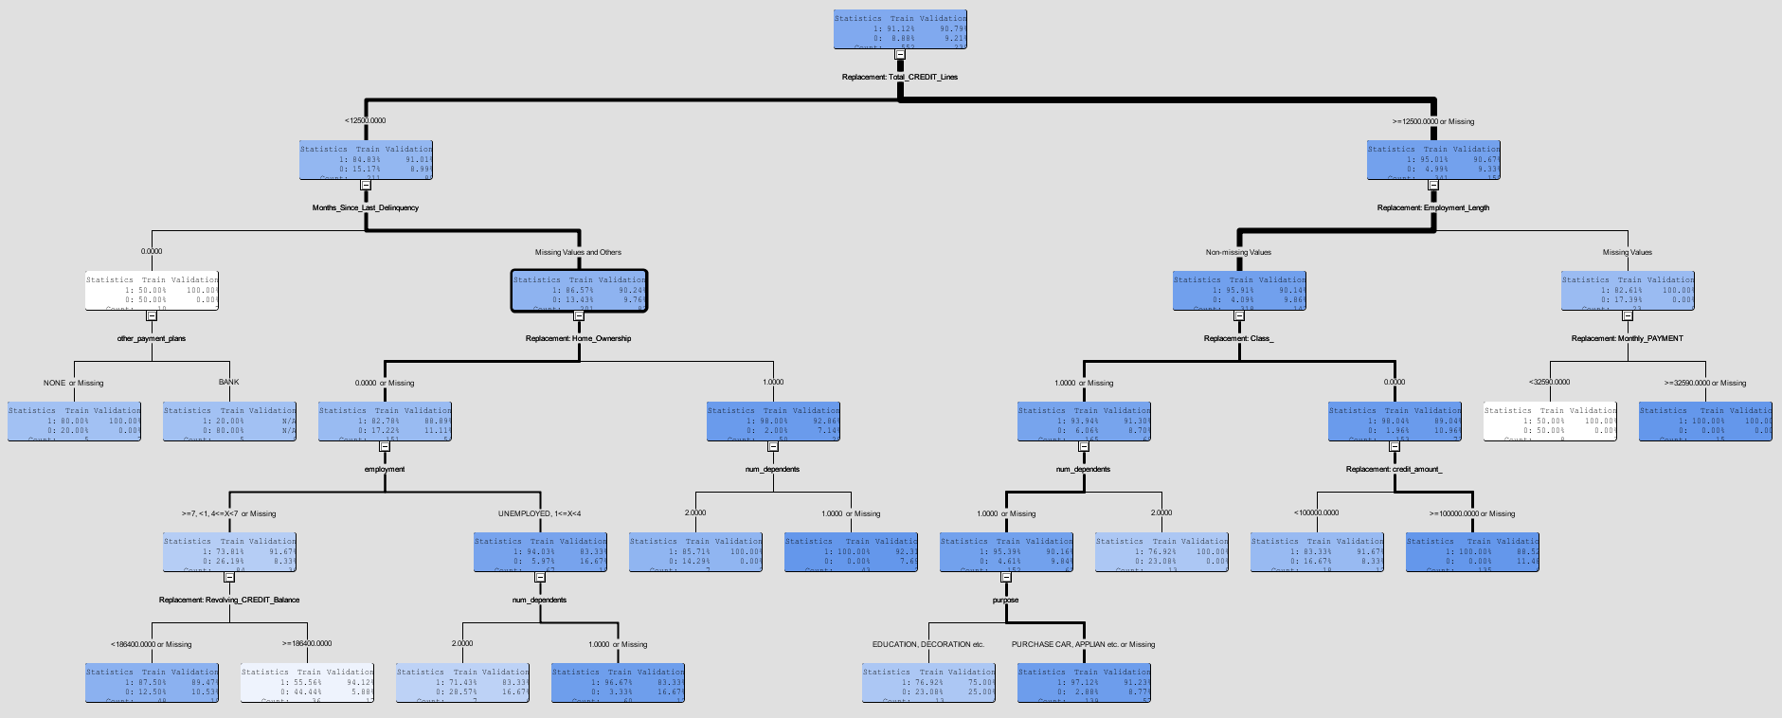
objective 1 - Decision Tree - Training node
Based on the highest log worth

Slide 21
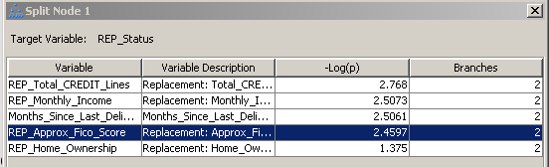
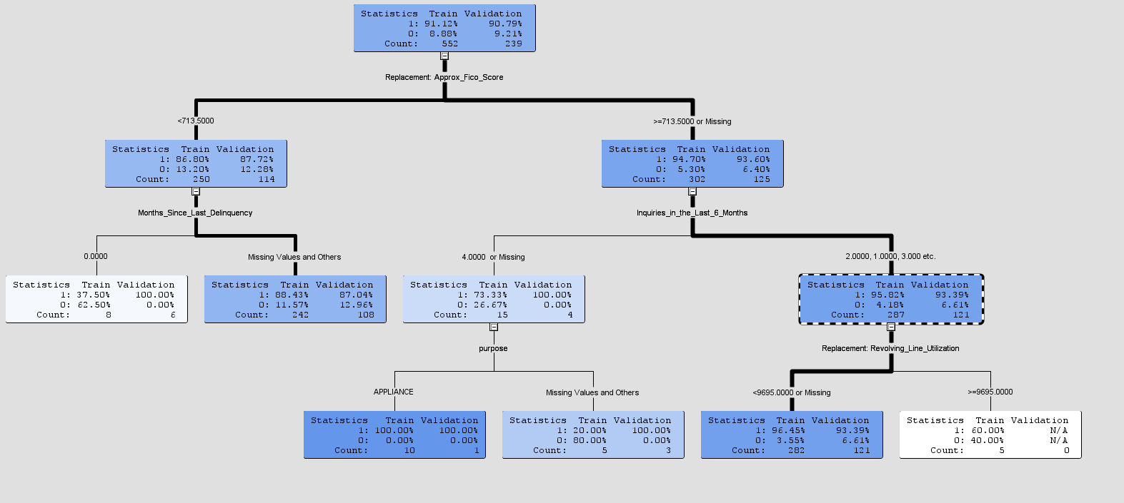
objective 1 - Decision Tree - Manually
Split Log worth >1

Slide 22
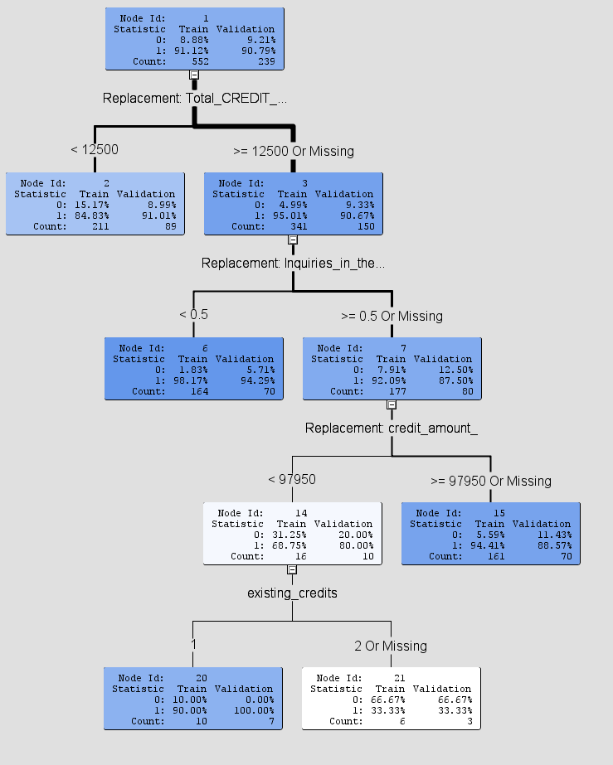
objective 1 - Decision Tree - Automatically

Slide 23
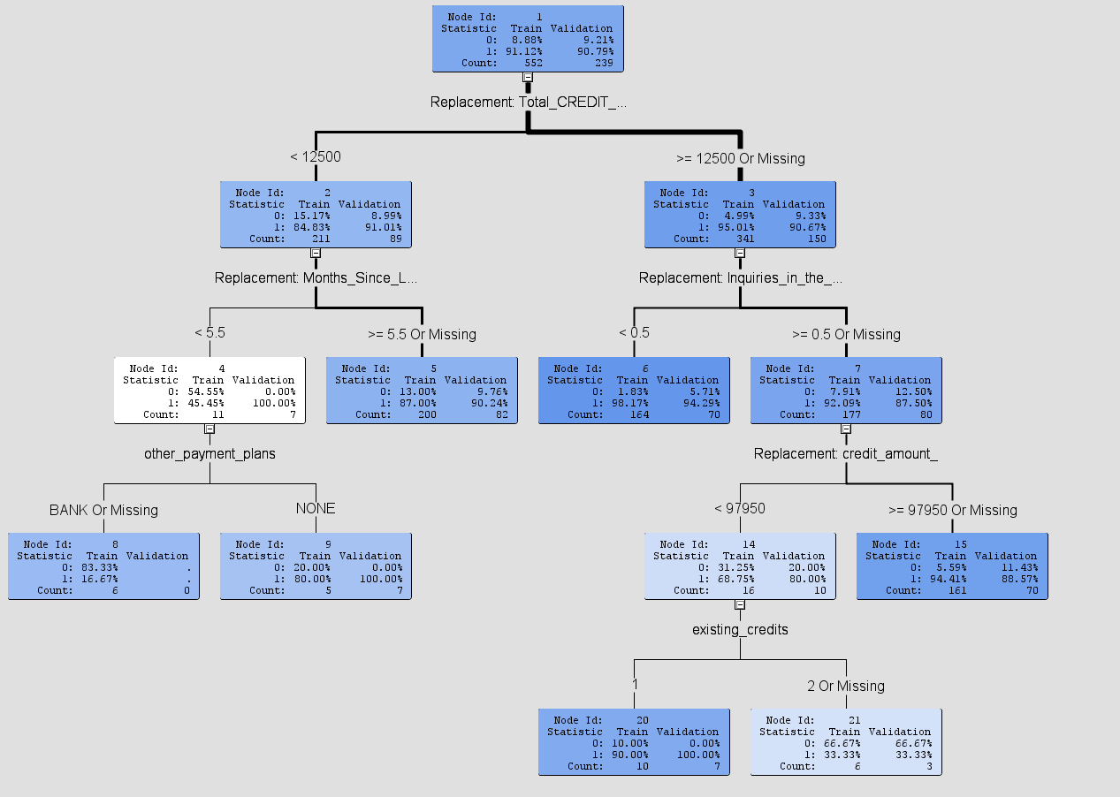
objective 1 - Decision Tree - Autonomously

Slide 24
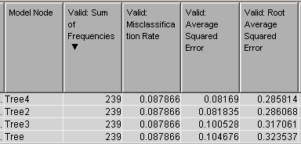
objective 1 - Decision Tree - Model comparison
Vaildation
ASE: 0.08169 Tree 4
Misclassification rate: 0.087866 (same)
Tree 4 -decision tree- autonomously is the best model

Slide 25
objective 1 - Overall Model comparison
 | ASE | Misclassification Rate
Decision Tree | 0.08169 (Lowest) | 0.087866 (Lowest)
Scorecard | 0.095059 | 0.108069
Regression | 0.100764 | 0.117155

Slide 26
Objective 2
To suggest useful marketing campaign and financial product to the group of customer

Slide 27
Objective 2 - Issue
Not able to develop suitable marketing campaign and financial product for specific type of customers
Want to sell more financial product to customer
Would like to use different marketing campaign to boost the revenue
Dataset used: Bank Marketing Campaign, Past Product Record

Slide 28
Objective 2 - Aim
Suggest different type of financial product to segmented customer
Base on the association relationship of financial product to suggest them to customer
Develop different marketing campaign for segmented customer
Attract customer to spent more with bank’s product
Increase satisfaction

Slide 29
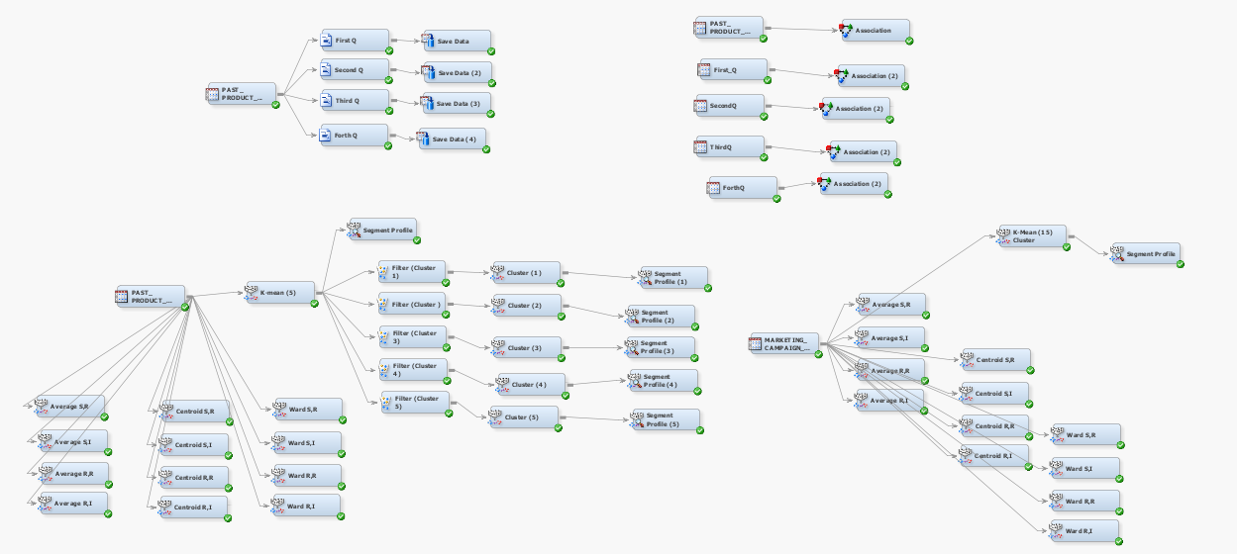
Objective 2 - Methodology
Using Association analysis to find out the correlation relationship of financial products
Use Clustering analysis to define customers into different groups

Slide 30
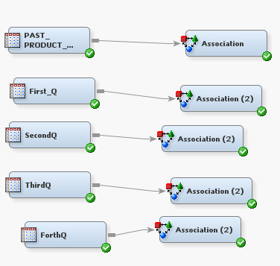
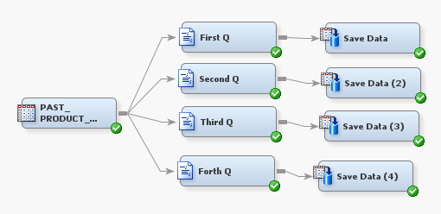
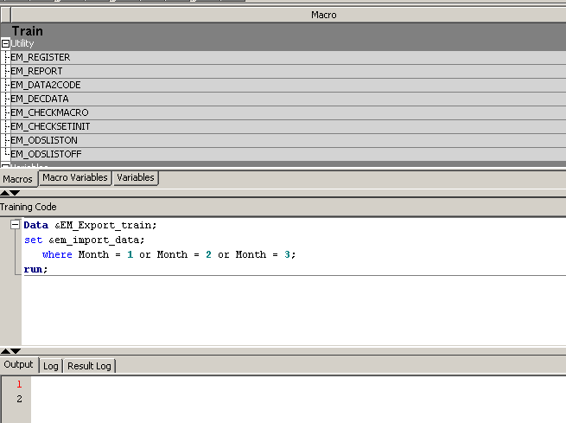
Objective 2 - Association Analysis
Use Association Node to process association analysis for the whole dataset for overall correlation rules
Use SAS code to seperate the dataset into different quarter for a more detailed reules

Slide 31
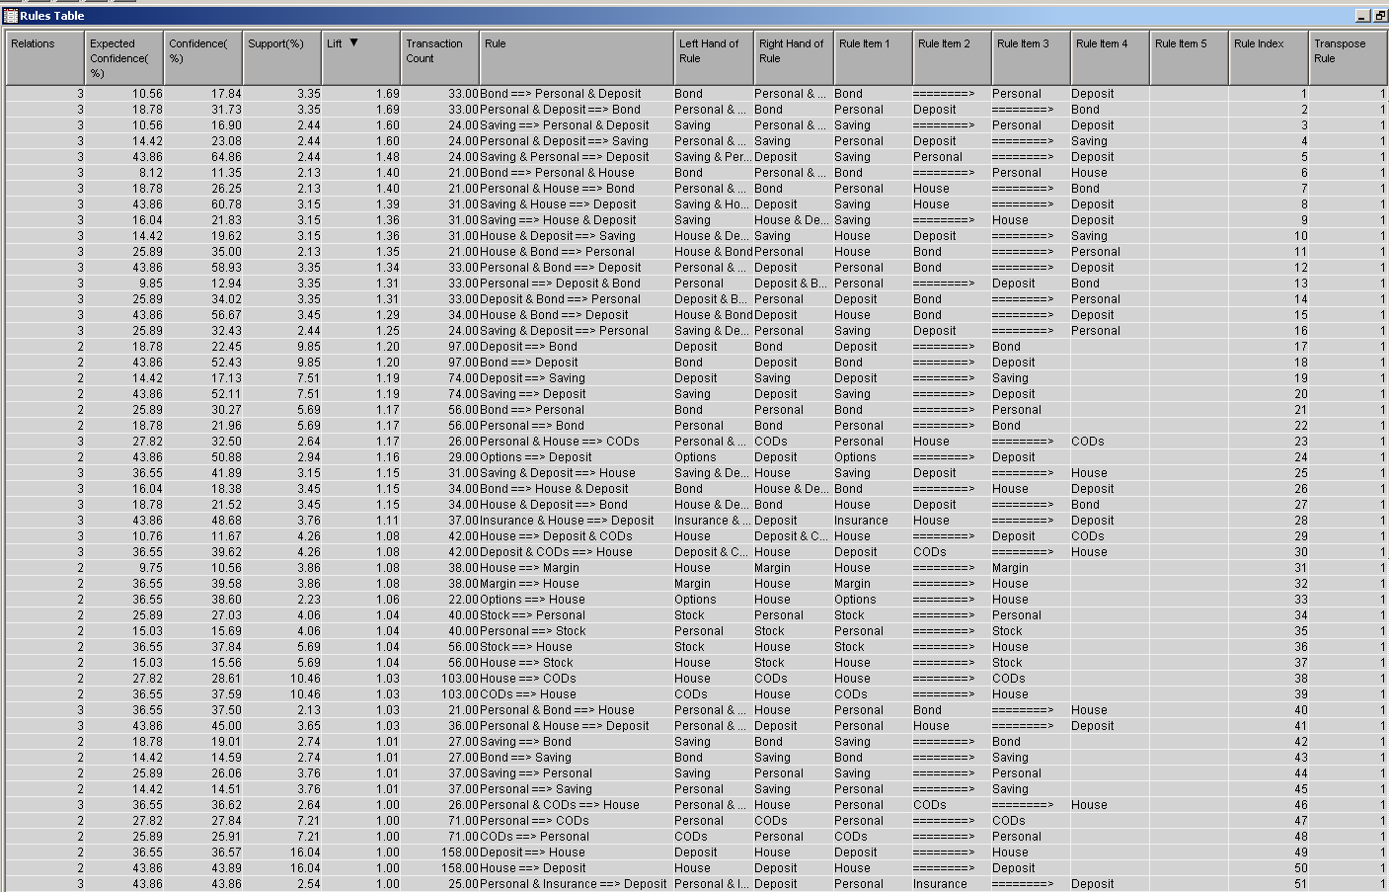
Objective 2 - Association Analysis (Result)
Overall rules
Choosing significant rules with lift>1

Slide 32
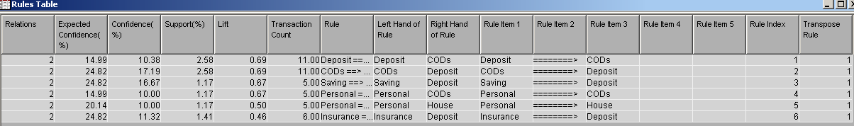
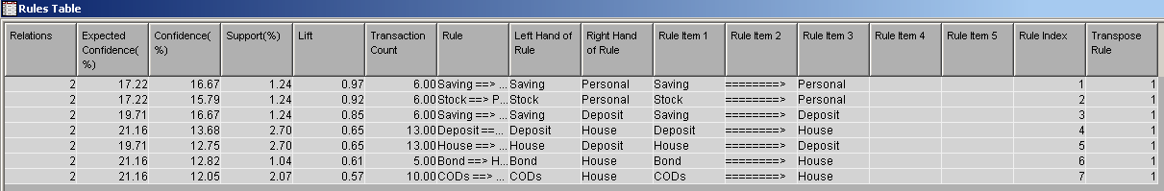
Objective 2 - Association Analysis (Result)
Quarter 1
Quarter 2

Slide 33
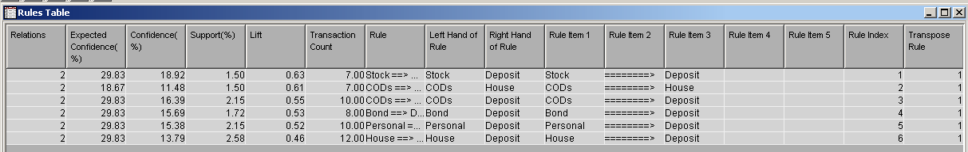
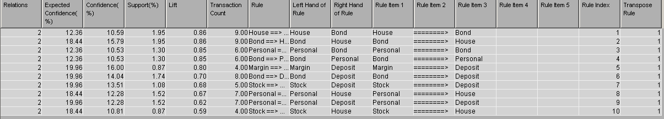
Objective 2 - Association Analysis (Result)
Quarter 3
Quarter 4

Slide 34
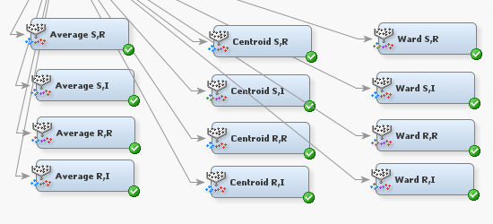
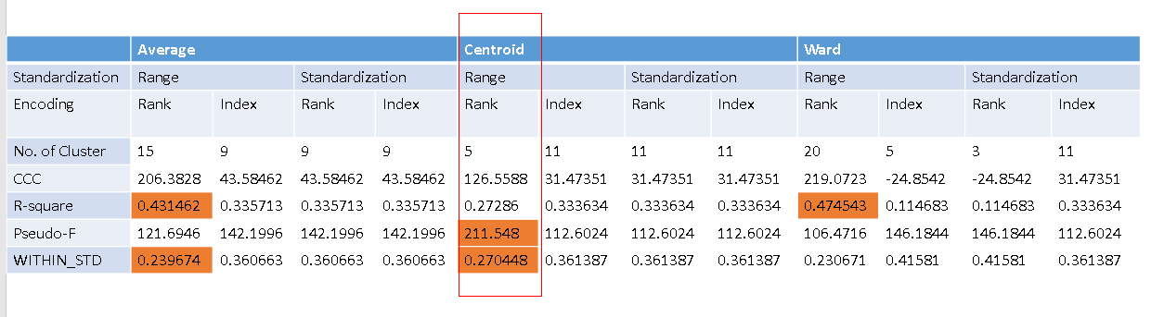
Objective 2 - Cluster Analysis (Financial Product)
Use Average, Centroid, Ward method
With different standardization and encoding method to find out the suitable (K)
Comparing CCC, RSQ, Pseudo-F and SSE

Slide 35
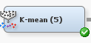
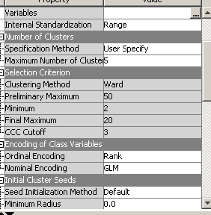

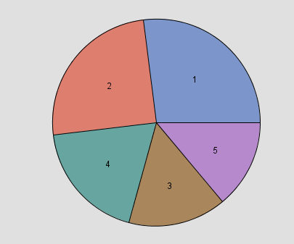
Objective 2
Objective 2 - Cluster Analysis (Financial Product)
User specificy method with 5 clustering group
Use Segment Profile Node to find out some interesting result

Slide 36
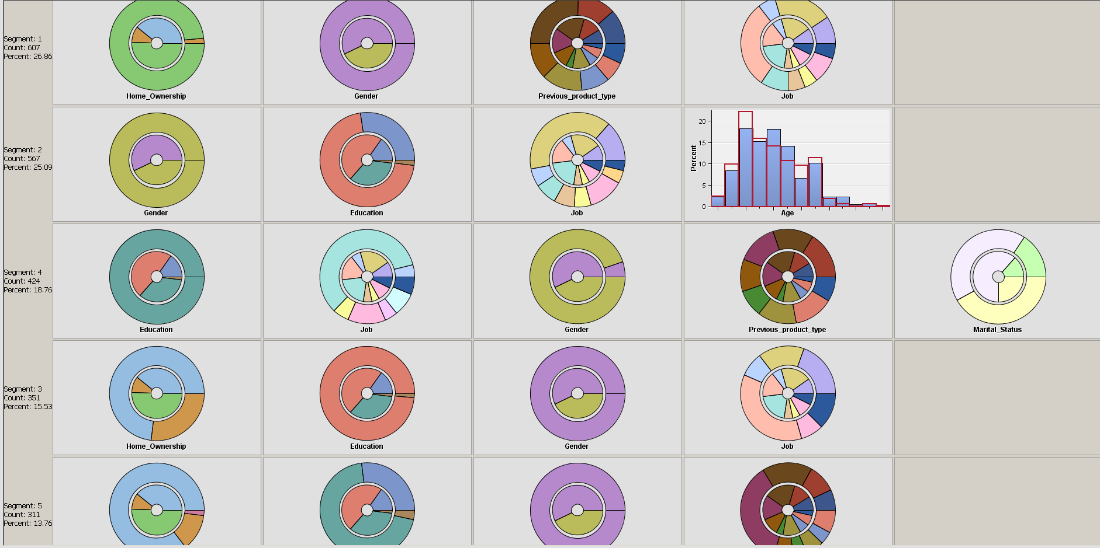
Objective 2
Objective 2 - Cluster Analysis (Financial Product)
Segment 1
Mainly Housemaid
Rent House
Segment 2
Male
Blue-collar
Segment 4
Tertitary Education
Management
Male
Segment 3
Mainly Housemaid
Mortgage House
Segment 5
Female
Tertitary Education
Mortgage House

Slide 37
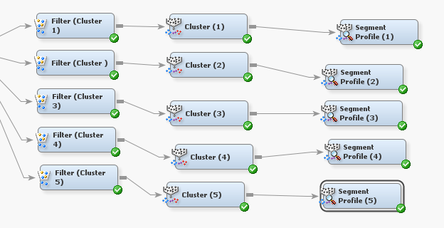
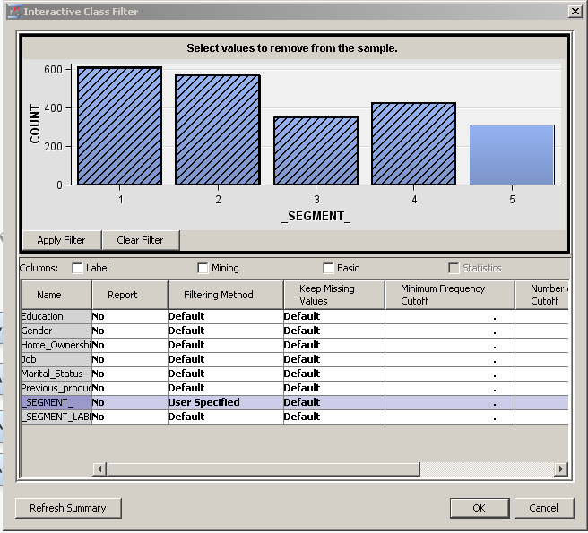
Objective 2
Objective 2 - Cluster Analysis (Financial Product)
Process a second level clustering to see more detail into each cluster
Also user specificy for 5 clustering group for the second level cluster

Slide 38
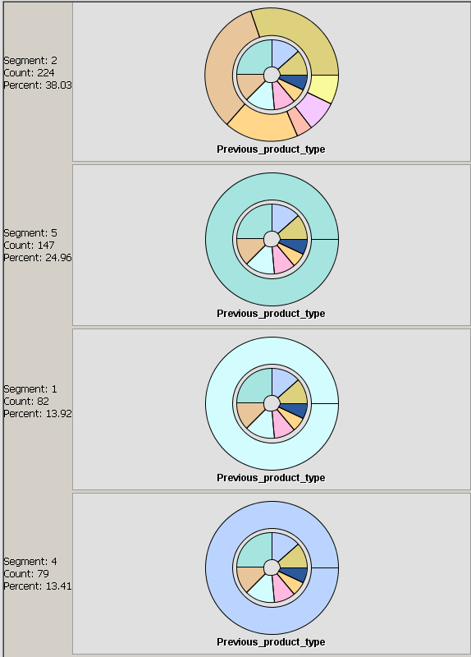
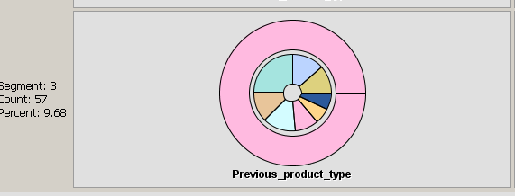
Objective 2
Objective 2 - Cluster Analysis (Financial Product)
Second level of cluster 1
Segment 1 : Personal
Deposit,Bond/Bond/Stock/Saving/CODs
Segment 2 : Mainly Bond
Personal,Deposit/Personal,House/Deposit/Personal/House,Deposit/Saving
Segment 3 : Saving
Personal,Deposit/House,Deposit/Deposit/Bond/Personal
Segment 4 : CODs
House/Personal
Segment 5 : Deposit
Bond/Saving/ House

Slide 39
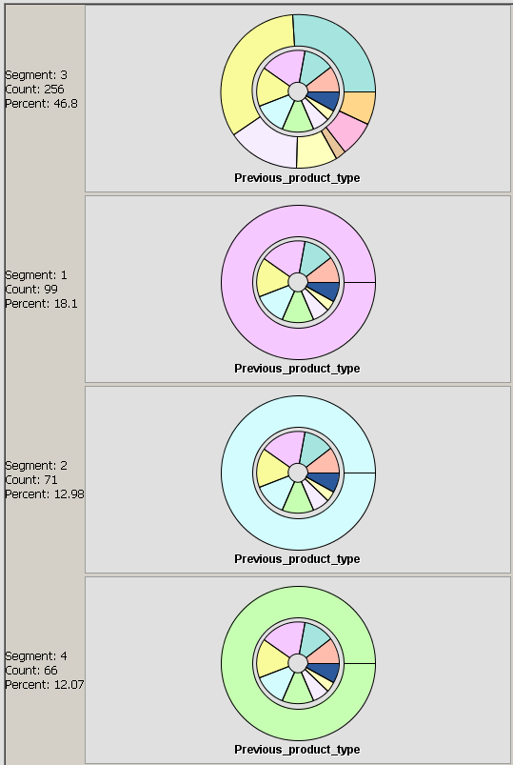
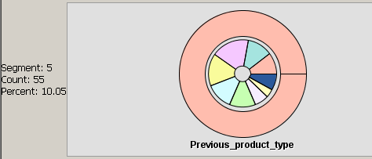
Objective 2
Objective 2 - Cluster Analysis (Financial Product)
Second level of cluster 2
Segment 1 : Deposit
Bond/Saving/House
Segment 2 : Insurance
No Useful Suggestion
Segment 3 : Mainly House
Deposit,CODs/Margin/Stock/CODs/Deposit
Segment 4 : Personal
Deposit,Bond/Bond/Stock/Saving/CODs
Segment 5 : Bond
Personal,Deposit/Personal,House/Deposit/Personal/ House,Deposit/Saving

Slide 40
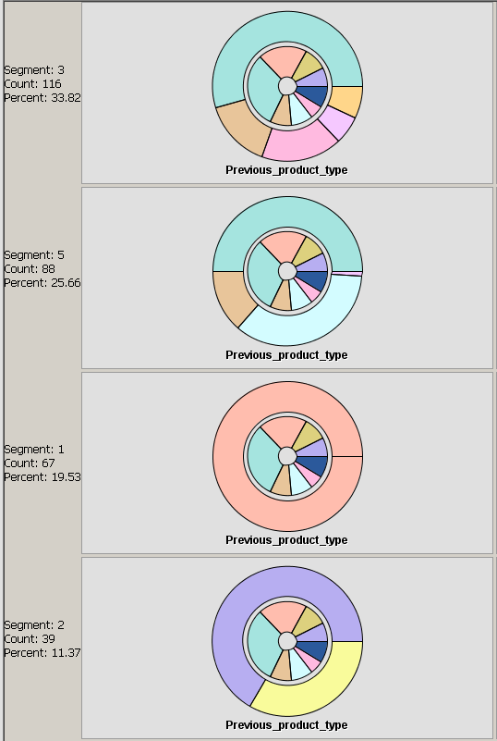

Objective 2
Objective 2 - Cluster Analysis (Financial Product)
Second level of Cluster 3
Segment 1 : Deposit
Bond/Saving/House
Segment 2 : Mainly Bond
Personal,Deposit/Personal,House/Deposit/Personal/House,Deposit/Saving
Segment 3 : Hose, Insurance
Deposit
Segment 4 : CODs
House/Personal
Segment 5 : Personal,House
Bond/CODs/Deposit

Slide 41


Objective 2
Objective 2 - Cluster Analysis (Financial Product)
Second level of Cluster 4
Segment 1 : Personal,Deposit
Bond/Saving
Segment 2 : Stock
Personal/House
Segment 3 : CODs
House/Personal
Segment 4 : House
Deposit,CODs/Margin/Stock/CODs/Deposit
Segment 5 : Margin
House

Slide 42


Objective 2
Objective 2 - Cluster Analysis (Financial Product)
Second level of Cluster 4
Segment 1 : Mainly Stock
Personal/House
Segment 2 : CODs
House/Personal
Segment 3 : Deposit
Bond/Saving/House
Segment 4 : House
Deposit,CODs/Margin/Stock/CODs/Deposit
Segment 5 : Saving
Personal,Deposit/House,Deposit/Deposit/ Bond/Personal

Slide 43

Objective 2
Objective 2 - Cluster Analysis (Marketing)
Use Average, Centroid, Ward method
With different standardization and encoding method to find out the suitable (K)
Comparing CCC, RSQ, Pseudo-F and SSE

Slide 44



Objective 2
Objective 2 - Cluster Analysis (Marketing)
User specificy method with 15 clustering group
Use Segment Profile Node to find out some interesting result

Slide 45


Objective 2
Objective 2 - Cluster Analysis (Marketing)
Consider segment 3
Mainly single
Young age
Low investment amount -> Not rich
Have personal loan
Mainly Male
Rent House

Slide 46
Objective 2
Objective 2 - Cluster Analysis (Marketing)
Suggestions for marketing campaign
Young Single
Mainly hedonism
Cooperate with entertainment venue such as karaoke, restaurant, party rooms and cinema for discount if they use the credit card by Banco for consumption
Cooperate with middle-price brand to provide discount by shopping with Banco’s credit card

Slide 47


Objective 2
Objective 2 - Cluster Analysis (Marketing)
Consider segment 6
Mainly housemaid
Have time deposit previously and currently
Female
Rent house with no housing loan
Average investment among -> middle class

Slide 48
Objective 2
Objective 2 - Cluster Analysis (Marketing)
Suggestions for marketing campaign
Middle class housemaid
Offer discount for some makeup and skin care product
Discount price for household appliances with using Banco credit card
Free membership for some beauty salon and massaging parlor
Discount for housing loan

Slide 49
Objective 3
To find the best model to predict the interest rate by different variables from clients.

Slide 50

Objective 3 - Background
Banco Bank want to set up a model that can predict the interest rate of each client with different characteristic
Dataset used: Merge
The dataset contain 1000 observations
It will be divided into 500 training data and 500 validation data in the part of Data Partition

Slide 51

Objective3 - model

Slide 52

Objective 3 - Transformation
After exploring the data in the dataset, we find that Average_credit_balance contains negative values, duration and credit_amount are not normally distributed.
So we use the standardize method to handle average_credit _balance, and log method to handle the duration and credit_amount.

Slide 53

Objective 3 - linear regression
After the transformation, we use a stepwise linear regression to predict the interest rate
Top: train
Bottom: validate

Slide 54

Objective 3 - linear regression

Slide 55
Objective 3 - linear regression

Slide 56

Objective 3 - neural network
Before the process of transformation, we use the neural network to predict the interest rate
Top: train
Bottom: Validate

Slide 57

Objective 3 - neural network
By observing the iteration plot, we know that we cannot have a better result by adding iteration times.
As the iteration times increases, the gap between the validate data and the train data become larger, suggesting that a huge number of weights in the fitted neural network model

Slide 58

Objective 3 - AutoNeural
The result of neural network is not satisfying, so we used AutoNeural with 2 hidden units to have a try.
Top: train
Bottom: validate

Slide 59

Objective 3 - AutoNeural
The iteration plot suggest that we can have a smaller Average Squared Error (ASE) by adding one hidden unit. But the ASE of 2 hidden units are very close to the ASE of 3 hidden units, so we do not add 1 hidden unit here.

Slide 60

Objective 3 - Ensemble
After constructing 3 models, we try to ensemble them together for a better model.
Top: train
Bottom: validate

Slide 61

Objective 3 - Ensemble
Here is the socre ranking matrix
Top: train
Bottom: validate

Slide 62

Objective 3 - Comparison
We had construct 4 model, which are regression model, neural network model, AutoNeural model and the ensemble model.
Top: Regression Bottom: Neural network

Slide 63

Objective 3 - Comparison
Top: Ensemble Bottom: AutoNeural

Slide 64

Objective 3 - Comparison
After the comparison, the ensemble model is selected as it as the lowest Average Squared Error (ASE) of 9.551761.
The second best model is AutoNeural and the third one is Regression.

Slide 65
Objective 4
To evaluate effectiveness, efficiency and profitability of current direct marketing Campaign

Slide 66
Objective 4 - Background
Banco Bank has set up a direct marketing campaign for subscribing a time deposit for 2 years (previous 2 years)
Want to set up a campaign for the same product this year
With better analysis with previous years record
Dataset used: Bank Marketing Campaign
Target(Y): Subscribe Deposit; Binary; “Yes”,”No”

Slide 67
Objective 4 - Aim & Assumption
Aims
Classify customers and predict outcome with recorded factors
Increase revenue of each successful case of the marketing campaign
Cost control on unnecessary expenditure
Assumptions for marketing cost
Contact Type
Direct: Branch/relationship manager meet with customers in bank branches - $700
Phone: Branch/relationship manager sell product through telephone - $500
Email: Send email to list of customers - $200

Slide 68



Objective 4 - Data Preparation
Unusual spike of value “0” found in variable “Revenue”
Use replacement node to replace it to missing value
Seperate data for training and validation samples
Use data partition node (each 50%)

Slide 69

Objective 4 - Methodology
1. Decision Tree 2. Logistic Regression 3. Neural Network 4. Profit Matrix

Slide 70

Objective 4 - Decision Tree
Step 1: Construct Decision Trees
Manually
Automatically
Autonomously
Step 2: Compare the trees and find the best decision tree
Step 3: The best decision tree will join the final model comparison

Slide 71

Objective 4 - Decision Tree (Manually)
Construct a split base on the highest log worth.
For the first split, we will choose the variable “outcome of previous campaign” as it has the highest log worth.

Slide 72

Objective 4 - Decision Tree (Manually)
No. of day < 180

Slide 73


Objective 4 - Decision Tree (Manually)

Slide 74

Objective 4 - Decision Tree (Automatically)

Slide 75

Objective 4 - Decision Tree (Automatically)
From the variable importance, evaluate the importance of inputs in decision tree
Example
Job explains 69.53% of the variability explained by outcome from previous campaign.

Slide 76


Objective 4 - Decision Tree (Automatically)

Slide 77

Objective 4 - Decision Tree (Autonomous)

Slide 78




Objective 4 - Decision Tree (Autonomous)

Slide 79

Objective 4 - Model Comparison (Decision Tree)
Decision Tree (Autonomous) has the highest ROC
Will join final model comparison
Model Description | Valid: Misclassification Rate | Valid: Average Squared Error | Valid: Kolmogorov-Smirnov Statistic
Decision Tree (Autonomously) | 0.114 | 0.08344072 | 0.782
Decision Tree (automatically) | 0.216 | 0.17201950 | 0.562
Decision Tree(Manually) | 0.236 | 0.17832837 | 0.531

Slide 80
Objective 4 - Findings from decision tree
8-leaf Decision Tree will be selected to predict if a particular customer will reposond/accept bank’s marketing campaign
For customers who contact with us more than 5.5 times, with occupation housemaid are more likely to subscribe deposit
For customers who contact with us less than 5.5 times, with occupation other than housemaid and age less than 54.5 are far less likely to subscribe deposit
For customers who contact with us more than 5.5 times, with less than 4.5 times times having contact with other marketing campaigns from bank are more likely to subscribe deposit.

Slide 81

Objective 4 - logistic Regression
Use log transformation to regulate skewed distribution in last contact duration and number of

Slide 82



Objective 4 - logistic Regression

Slide 83

Objective 4 - logistic Regression (Stepwise)
with a=0.1

Slide 84


Objective 4 - logistic Regression (Stepwise)

Slide 85


Objective 4 - logistic Regression (Stepwise)

Slide 86
Objective 4 - Findings for Logistic Regression
Significant Variables: number of contacts, outcome of previous campaign, job(occupation), number of contacts with other marketing campaign, contact method, last contact quater, and age
→ These significant variables will be used to be weights in neural network

Slide 87

Objective 4 - Neural Network
Multilayer Perception with 6 Hidden layers
Neural vs auto neural
Direct Neural Network vs Neural Network with input selection

Slide 88


Objective 4 - Neural Network (Direct)
Neural Network
Auto Neural Network

Slide 89


Objective 4 - Neural Network (Input selection)
With significance variables: number of contacts, outcome of previous campaign, job(occupation), number of contacts with other marketing campaign, contact method, last contact quater, and age
Neural Network
Auto Neural Network

Slide 90
Objective 4 - Model Comparison (Full)
 |  | ASE Validation
Regression | Stepwise | 0.094641268806
Neural Network | Direct | 0.087234410524
 | Input Selection | 0.084083849218
Auto-Neural | Direct | 0.092149019051
 | Input Selection | 0.081247519234
Auto-Neural (Input Selection) Method is selected due to its low Validation ASE

Slide 91

Objective 4 - Model Comparison (Full)
Auto NN (Input Selection)

Slide 92


Objective 4 - Profit Matrix
Revenue = 3% of invest amount

Slide 93


Objective 4 - Profit Matrix
Model Selection is performed on validation profit
Based on the new criterion, the selected model is Regression (Stepwise), NN(input selection is second close)

Slide 94

Objective 4 - Profit Matrix
The total expected profit shows the amount of value added within each 5% block of data
Appears that all models select approximately 90% of the cases
Amount plotted: 10856.12(#Subscribe deposit =1)-541.767(#Subscribe deposit =0) for solicited case and 0 for ignore cases

Slide 95

Objective 4 - Profit Matrix
plot: sensitivity vs selected fraction
By selecting 80% of the data can capture around 85% of the primary outcome cases.

Slide 96
Objective 4 - Findings Summary
Good Performance for previous year marketing campaign outcome
Effectiveness
Target customers with characteristics(significant variables) that more likely to have a positive outcome
Age>49.5, job=housemaid...etc
Profitability
Increase response rate
Induce customer to apply so as larger target customer base e.g. sogo/supermarket coupon
Cost Control
Evaluate potential customers before actions
Use high cost contact (Direct) method only with right targeted customers

Slide 97
Objective 5
Analyze the factors for active customer and predict whether a new customer will be actively use financial service in the bank

Slide 98
Objective 5- Aims
Banco provide financial service to their customer in charge
It requires high cost to obtain new customer
The customers who are not actively use the bank service may cause the loss for the bank
If the bank can predict whether the customer will be actively use the service, then they can increase the number of active customer and therefore decrease the cost

Slide 99

Objective 5- model
Decision tree 2. Neural Network 3. Memory Based Reasoning

Slide 100
Objective 5- Data preparation
Data set used: loan risk+loan state(1000 obs)
Replacement:
replace the class as 1 and 0. => Active as1 and inactive as 0
replace the checking status=>replace “no checking” as missing value
Data Partition: separate the data set into training and validation
=> 70% in training and 30% in validation

Slide 101


Decision Tree-Model
Manually split =>Split the node based on
the log worth
Training node=>Use the training node int eh interactive function
Automatically: Directly run the decision tree model
Split

Slide 102

Decision Tree - Result Comparison
Overall, The Automatically and Training node one has better performance than Manually decision tree model.

Slide 103
Decision Tree - Result Comparison
 | Valide ROC index | Misclassification rate | ASE
Manually | 0.666 | 0.28 | 0.1894
Training Node | 0.679 | 0.28 | 0.1906
Automatically | 0.678 | 0.27 | 0.1825
Amount three models, the automatically one can provide lowest misclassification rate and average squared error
=>Choose Automatically model for analysis in detail

Slide 104

1. Decision tree-Automatically(Result)
For people who has more than 200,000 saving in checking account may be the active user for the service
=>use the service more often
2. For the customers have less than the amount, if they had paid all credit amount before, they are less likely to use the service.

Slide 105

2. Neural Network
Multilayer perceptron are used
Hidden nodes are used
 | Discription
Neural Network | All of variables are treated as input
NN(Top5) | 5 highest weight variables are chosed for analysis
NN(Top4) | 4 highest weight variables are chosed for analysis
AutoNeural | SAS AutoNeural node are used for analysis

Slide 106
Neural Network-Variables
Residence_since
Saving_status
Qualification
Checking status
Other_payment
Top 4 weight
Top 5 weight

Slide 107

2. Neural Network- Result Comparison

Slide 108
2. Neural Network
 | Misclassification rate | ASE | ROC index
AutoNeural | 0.23667 | 0.22721 | 0.64
NN(Top5) | 0.26333 | 0.22029 | 0.644
Neural NN(Top4) | 0.26667 | 0.21680 | 0.609
Neural Network | 0.29000 | 0.24793 | 0.525

Slide 109


2. Neural Network-autoNeural

Slide 110
2. Neural Network-autoNeural-Confusion Matric
Training
 | Predict active | Predictive inactive
Actual active | 476 | 27
Actual inactive | 67 | 133
Validation:
Sensitivity: 0.875
Specificity: 0.476
Accuracy: 0.763
Viladation
 | Predict active | Predictive inactive
Actual active | 189 | 27
Actual inactive | 44 | 40

Slide 111

3. MBR
Find nearest neighbors to predict the result
Using interactive grouping to transfer catagory data into continous ones
Change the number of neighbors to find the best outcome

Slide 112

3. MBR-Interactive Grouping
savings_status | checking_status | credit_history
employment | housing | other_payment_plans

Slide 113

3. MBR- Comparison
1. The one without grouping has worse performance than other 3
2. Have better performance in Train data when the neighbor is less

Slide 114
3. MBR- Comparison
 | Misclassification rate | ASE | ROC index
MBR(Low neighbor) | 0.27000 | 0.18953 | 0.685
MBR | 0.28667 | 0.18838 | 0.706
MBR(High neighbor) | 0.29000 | 0.19089 | 0.695
MBR(4) | 0.31000 | 0.20723 | 0.56

Slide 115
3. MBR- Low Neighbor’s Comfusion Matrix
Training
 | Predict active | predict inactive
Actual active | 468 | 35
Actual inactive | 121 | 76
Validation:
Sensitivity: 0.926
Specificity: 0.226
Accuracy: 0.73
Validation
 | Predict active | predict inactive
Actual active | 200 | 16
Actual inactive | 65 | 19

Slide 116

4. Comparison
Choose the best model in each method and make comparison for their predict power
1. NN has higher predict power on high false active rate
2. DT and MBR can do better on low false active rate

Slide 117
4. Comparison
 | Missfication Rate | ASE | ROC index
AutoNueral | 0.23667 | 0.22721 | 0.64
Decision Tree(automatically) | 0.27 | 0.1825 | 0.678
MBR(low neighbor) | 0.27 | 0.18953 | 0.685

Slide 118
THE END Q&A

